Slide 1
Ambulatory PCP Group
Journey to a SSOT
Presenters: Greg Anderson and Liz Turi
April 6, 2019
Andrew Cadorette
Lauren Rodriguez
Phil Smith
Abhishek Gorla
Anne Van Haaren
Julian Niever, MD
Christina Polomoff, PharmD, BCACP, BCGP
Stacy Ward-Charlerie
Aya Salmeh
Dan Russell
Zeeshan Ahmed

Slide 2
Problem: Suboptimal Medication Management Processes that can lead to poor patient outcomes in the ambulatory setting.
Current Systems result in:
Fragmentation of Data,
Siloed, inefficient workflow,
Uninformed decision-making (liability), all
Leading to preventable ADE’s and unnecessary costs.

Slide 3
Current Med Rec is “RECKLESS!”

Slide 4
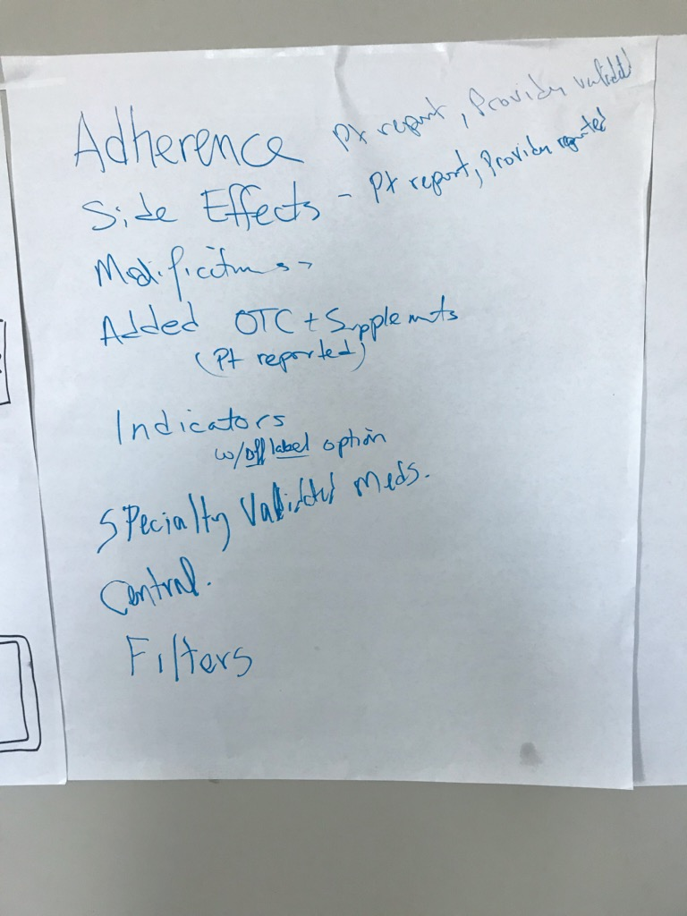
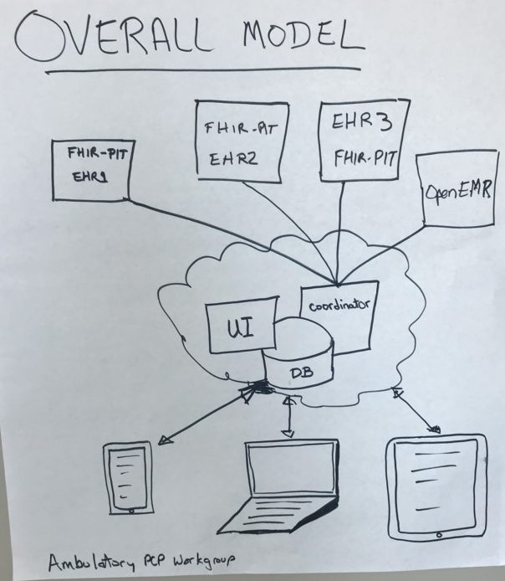

Slide 5
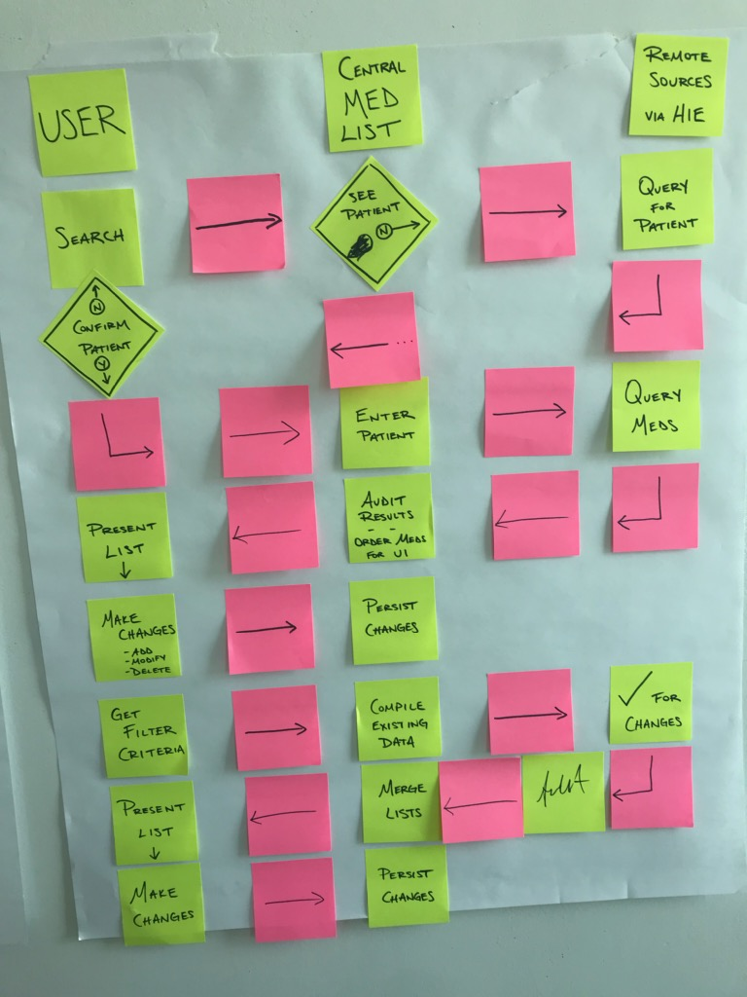
Data Flow/ User Interaction

Slide 6
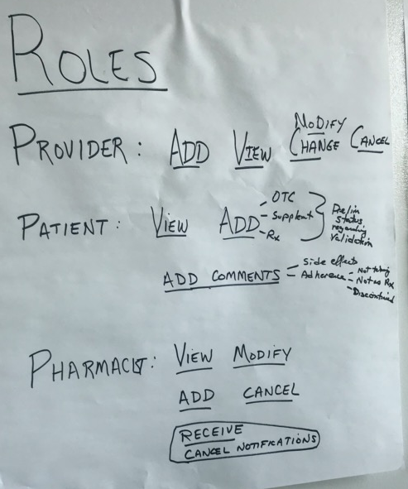
Roles

Slide 7
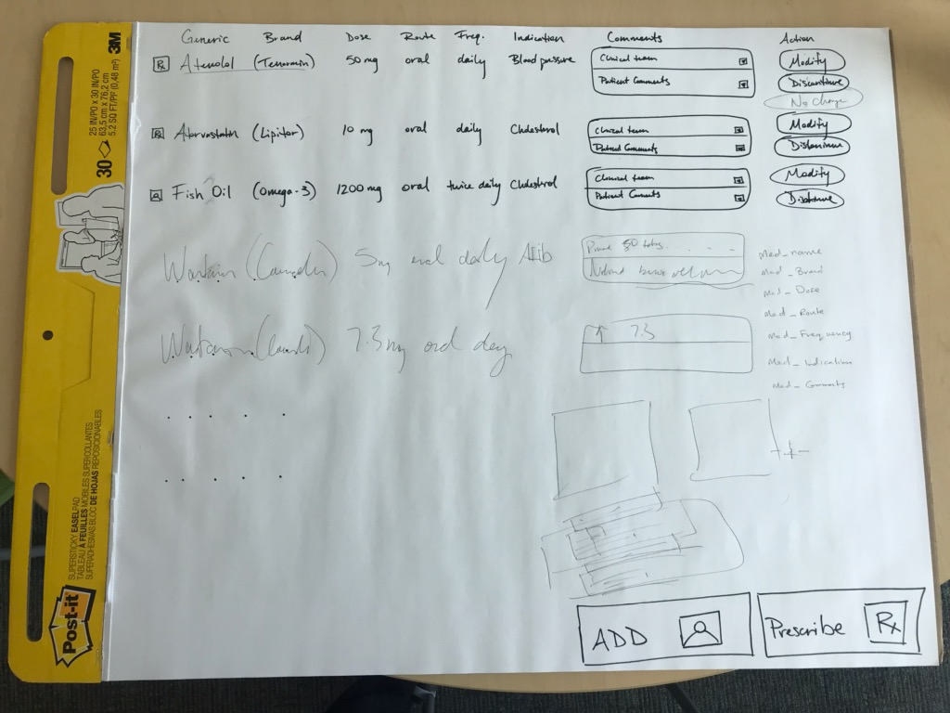
UI

Slide 8
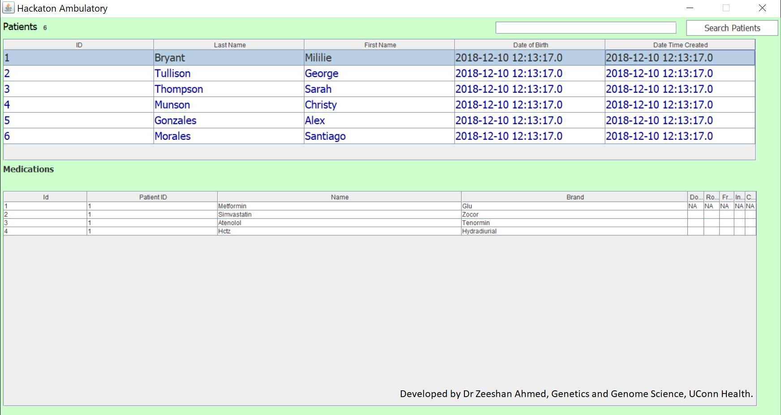
WIREFRAME
Filter/Sort meds by attribute or name
Provider: Add/Modify/Cancel/Validate
Pharmacist: Add/Modify
Patient: Add Comment
Dose
Route
Frequency
Indication
Comments (latest comment shown)

Slide 9
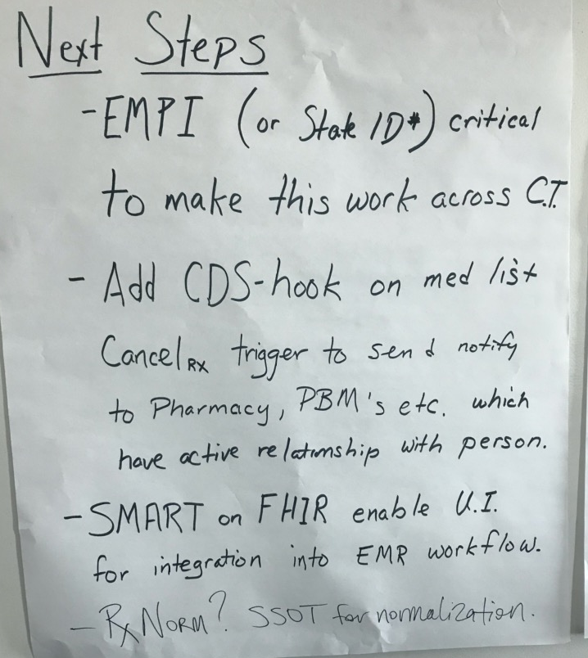
Next Steps

